Slide 1
Azure SQL: What to use when
Anna Hoffman
Data & Applied Scientist / PM , Microsoft
Moderator: Rie Irish, Microsoft
Notes:
2 min

Slide 2
Agenda
Azure SQL History
What to use when
Demos
Potential SQL Injection
Auto-failover groups
Geo-replication
Comparing failover times
Hyperscale
More
Questions
Notes:
Keep questions at the end

Slide 3

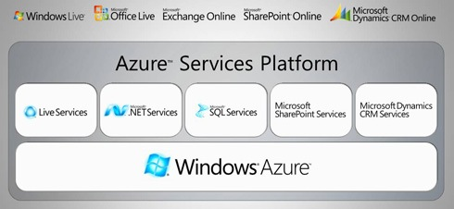
History of Azure SQL
[Azure SQL Database] is a cloud database offering that Microsoft provides as part of the Azure cloud computing platform. Unlike other editions of SQL Server, you do not need to provision hardware for, install or patch [Azure SQL Database]; Microsoft maintains the platform for you. You also do not need to architect a database installation for scalability, high availability or disaster recovery as these features are provided automatically by the service.
Notes:
Before we talk about Azure SQL and what to use when, let's briefly consider where it started. In 2008, at the Microsoft Professional Developers Conference, Microsoft's Chief Software Architect (at the time) Ray Ozzie announced the new cloud computing operating system, Windows Azure (or "Project Red Dog"), which was later changed to Microsoft Azure. One of the five key components of the Azure Services Platform launch was "Microsoft SQL Services." From the beginning, SQL has been a big part of Azure.
An explanation of when you would want to use the early Azure SQL Database (2010) is as follows: [Azure SQL Database] is a cloud database offering that Microsoft provides as part of the Azure cloud computing platform. Unlike other editions of SQL Server, you do not need to provision hardware for, install or patch [Azure SQL Database]; Microsoft maintains the platform for you. You also do not need to architect a database installation for scalability, high availability or disaster recovery as these features are provided automatically by the service. Any application that uses [Azure SQL Database] must have Internet access in order to connect to the database.
This explanation still remains valid today, though the capabilities around security, performance, availability, and scale have been enhanced greatly.

Slide 4
Azure SQL has come a long way
2006
CloudDB
RedDog
2008
Windows Azure and SQL Data Services announced
2010
Windows Azure and SQL Azure launch
2012
SQL Azure →
Azure SQL Database
2013
Azure
Virtual Machines
2014
Windows Azure → Microsoft Azure
2015
Azure SQL Database V12
2016
Azure SQL Database Elastic Pools
2018
Azure SQL Database Managed Instance
2019
Azure SQL Database Hyperscale
Azure SQL Database Serverless
Azure SQL
Instance Pools
Notes:
Azure SQL has evolved over the years to include Virtual Machine, Managed Instances, and several options for Databases. There are now multiple deployment options with the flexibility to scale to your needs, and there have been over seven million deployments of some form of Azure SQL. The architecture for Azure SQL has also evolved to meet the ever growing demands of applications. E.g. elastic databases, vCore choices, Business Critical deployments, Hyperscale, and Serverless architectures.
Since 2008, SQL Server has changed a lot and Azure SQL has changed a lot. It's no surprise then that the role of the SQL Server professional has also changed a lot and today I want to help you become an Azure SQL professional.
2006
CloudDB Project
RedDog Project
2008
Windows Azure and SQL Data Services announced at PDC
2010
Windows Azure and SQL Azure officially launch.
2012
SQL Azure branded Azure SQL Database
2013
Azure Virtual Machines released
2014
Windows Azure branded Microsoft Azure
2015
Azure SQL Database V12 released
2016
Azure SQL Database Elastic Pools released
2018
Azure SQL Database Managed Instance released
2019
Azure SQL Database Hyperscale Released
Azure SQL Database Serverless Released

Slide 5
Introducing Azure SQL
Choose the right Azure database for your needs
SQL Server on Azure virtual machines
Azure SQL managed instance
Azure SQL Database
Best for migrations and applications requiring OS-level access
Best for most lift-and-shift migrations to the cloud
Best for modern cloud applications. Hyperscale and serverless options are available
Infrastructure as a service
Platform as a service
Notes:
SQL virtual machines
Azure manages the host and hardware
You manage the Virtual Machine
Azure provides value-add services
Managed instances
Azure manages the host, hardware, and Virtual Machine
You manage the SQL Server
Azure provides PaaS services
Databases
Azure manages the host, hardware, virtual machine, and SQL Server
You manage the database
Azure provide PaaS services

Slide 6

SQL Server on Azure VMs provides the promise of the cloud while maintaining OS control
Key features
SQL Server and OS server access
Expansive SQL and OS versions
Windows, Linux, Containers
File stream, DTC, and Simple Recovery model
SSAS, SSRS, and SSIS
Azure differentiators
Free Extended Security Updates for SQL Server 2008/R2
Automated Backups and Security Updates
Point in Time Restore with Azure Backup
Accelerated storage performance with Azure Blob Caching
435 percent overall return on an Azure IaaS investment over five years¹
Customer challenge
I want to migrate to the cloud as fast as possible but maintain operating system control and complete SQL Server functionality
Solution
Get the combined performance, security, and analytics of SQL Server, backed by the flexibility, security, and hybrid connectivity of Azure
Healthcare software manufacturer saves costs when reusing licenses while moving 600 on-premises VMs to Azure
1. Forrester Consulting. The Total Economic Impact™ of Microsoft Azure SQL Database Managed Instance.
Notes:
Best for migrations and applications requiring OS-level access
Challenges
The contract on my hardware is expiring
I have instances of SQL Server 2008 and 2008 R2
I want to migrate to the cloud as fast as possible
I use third party software that needs OS-level access
I have dependencies on SSRS
I want to extend our on-premises apps to Azure
I need an unlimited number of DBs
I want the full feature set of SQL Server 20XX
Solution
SQL Server and OS server access
Expansive SQL and OS version support
File stream, DTC, and Simple Recovery model available
Automated patching and backup
Free Extended Security Updates for SQL Server 2008/R2*
435 percent overall return on an Azure IaaS investment over five years (Forrester Consulting)
Up to 3.4x faster and 87% cheaper than AWS EC2**
Azure Key Vault integration
Support for Linux and Windows
Note: maybe only 1 here – the best one, rest in notes
Does your application require custom VM or SQL config? DB engine version choice, feature compatibility with SQL box, app portability, access to VM/OS
* ESU worth 75% of license every year for the next three years after EOS; ** Applicable to Azure Marketplace images, customers using customer SQL Server 2008/R2 custom images can download the ESU for free and manually apply.
VMs: Allscripts https://customers.microsoft.com/en-us/story/allscripts-partner-professional-services-azure
Move 600 VMs to Azure within a few weeks. Some time later moving some to MI
Rehost SQL Server 2008 and 2008 R2 in Azure Virtual Machines to get three years of Extended Security Updates at no additional charge and upgrade to a newer version when ready
435 percent overall return on an Azure IaaS investment over five years (for a composite organization based on the interviewed customers) (Forrester Consulting)
https://azure.microsoft.com/en-us/overview/azure-vs-aws/cost-savings/#sql-server-iaas

Slide 7
SQL Server on Azure Virtual Machines
Deployment Choices
Marketplace pre-installed SQL Server on Windows or Linux
Install your own SQL Server
Lift and Shift with Azure Migrate (Azure Site Recovery)
Resource Provider
Unlock Licensing and Edition Flexibility
Automated Backups and Security Updates
Manage VMs through Azure SQL in portal
Sizes and Storage Performance
Memory or Storage optimized sizes for best performance
Data and log on Premium Storage Managed Disks
Azure Blob Read Caching for data disks
Tempdb on local SSD
Ultra disks for extremely low latency needs
Networking and Security
Virtual Networks to integrate with on-premises
Advanced Data Security services (Preview)
HADR
Azure VM built-in HA
Azure Storage built-in DR
Azure Backup and Automated backups to Azure Blob Storage
Failover Cluster Instance with Azure Premium File Share
Always On Availability Groups with Cloud Witness
Hybrid Availability Group Secondary replicas
HADR on RedHat Linux with Pacemaker and fencing
File-Snapshot Backups
Notes:
Spend time on resource provider
Spend time on Advanced data security

Slide 8
Demo
Advanced threat protection in SQL Server in Azure VM
Notes:
SQL Server VM:
Deploy Log Analytics workspace
Connect windows computers to Azure monitor
Change 4 things in the registry
Restart the machine
Download the agent and configure
Verify connectivity
https://docs.microsoft.com/en-us/azure/azure-monitor/platform/agent-windows
Enable it on my subscription
Set up email alerts
https://docs.microsoft.com/en-us/azure/security-center/security-center-iaas-advanced-data
SQL DB/MI:
Toggle ADS switch
Deploy Log Analytics workspace

Slide 9
IaaS vs PaaS
Business continuity
High availability
Automated backups
Long term backup retention
Geo-replication
Scale
Advanced security
Versionless
Built-in monitoring
Built-in intelligence
Notes:
Use ADS as a transition here
Spend time on versionless
Versionless
Azure SQL Database and Managed Instance are versionless
Our “main branch” powers SQL Server, Azure SQL Database, and Managed Instance.
Microsoft consistently updates SQL Server instances
@@VERSION does not align with SQL Server versions
Fixes and feature updates not controlled by users
But…worry-free patching for both underlying OS and SQL Server
Updates are rolled out in “trains”.
New features can be whitelisted to specific customers (aka Private Preview)
Public Preview is typically available to all but limited support and discount pricing (if applicable)
All fixes in SQL Server eventually show up in Azure but timing may be different from CU
Not all fixes in Azure make it into a CU for SQL Server (but typically next major release)
Some fixes are specific to Azure
Follow these links to see new features, major fixes, and feature updates

Slide 10

Azure SQL managed instance eases cloud migration
Key features
Single instance or instance pool
SQL Server surface area (vast majority)
Native virtual network support
Fully managed service
On-premise identities enabled with Azure AD and AD Connect
Azure differentiators
Near zero downtime migration using log shipping
Fully managed business continuity with failover groups
Projected return on investment of 212 percent over three years¹
The best of SQL Server with the benefits of a managed service
Customer challenge
I want to migrate to the cloud, remove management overhead, but I need instance-scoped features (Service Broker, SQL Server Agent, CLR…)
Solution
Managed instance combines leading security features with SQL Server compatibility and business model designed for on-premises customers
Komatsu easily migrated 1.5 TBs of data thanks to near complete compatibility with SQL Server, plus 49% cost reduction and 25-30% performance gains.
1. Forrester Consulting. The Total Economic Impact™ of Microsoft Azure SQL Database Managed Instance.
Notes:
Best for most lift-and-shift migrations to the cloud
It is called an Instance because it is equivalent to a Database Engine Instance of SQL Server which we define actually in our docs at https://docs.microsoft.com/en-us/sql/database-engine/configure-windows/database-engine-instances-sql-server?view=sql-server-ver15. The term Database Engine Instance is important because other instance types for SQL Server are things like SSAS.
It's called Managed because it is a PaaS version of a Database Engine Instance where we manage several things including install of SQL Server, scaling, and high-availability.
Challenges
I want to migrate to Azure
I want to remove some of the management overhead and stress with regards to business continuity, high availability, and disaster recovery
I need instance-scoped features like SQL Server Agent, Database Mail, Service Broker, CLR, etc.
Solution
Single instance or Instance pool
SQL Server surface area (vast majority)
Native virtual network support
Fully managed Service
Enable your on-premise identities on cloud instances, through integration with Azure Active Directory and AD Connect
Near zero downtime migration using log-shipping
Fully managed business continuity with failover groups
Projected return on investment of 212 percent over three years (Forrester Consulting)
Combine the best of SQL Server with the benefits of a managed service
You get two levels of isolation:
Cluster level: Managed Instances for a tenant are fully isolated from other tenants. No connectivity or resource sharing is possible between different tenants.
Networking level: joining instances to a subnet in a VNET and restricting access to private IP addresses only provides full isolation from public Internet.
Managed Instance: Komatsu https://customers.microsoft.com/en-us/story/komatsu-australia-manufacturing-azure
Moved about 1.5 TBs of data very smoothly because of the near 100% compatibility with SQL Server
49% reduction in cost and 25% increase in performance gains

Slide 11
Active geo-replication vs auto-failover groups
 | Geo-replication | Auto-failover groups
Automatic failover | No | Yes
Fail over multiple databases simultaneously | No | Yes
Update connection string after failover | Yes | No
Managed instance supported | No | Yes
Can be in same region as primary | Yes | No
Multiple replicas | Yes | No
Supports read-scale | Yes | Yes

Slide 12
Demo
Auto-failover groups with SQL Managed Instance or SQL Database
Notes:
https://github.com/microsoft/sqlworkshops-azuresqlworkshop/blob/master/azuresqlworkshop/05-Availability/fg/fg-powershell.ipynb

Slide 13

Azure SQL Database is built for modern cloud apps
Key features
Single database or elastic pool
Hyperscale storage (100TB+)
Serverless compute
Fully managed service
Private link support
High availability with AZ isolation
Azure differentiators
Industry highest availability SLA of 99.995%
Industry only business continuity SLA with 5 second RPO and 30 second RTO
Price-performance leader for mission-critical workloads while costing up to 86 percent less than AWS RDS (GigaOm)
Customer challenge
I want to build modern apps, potentially multi-tenanted, with the highest uptime and predictable performance
Solution
Azure SQL Database is a highly scalable cloud database service with built-in high availability and machine learning
AccuWeather uses Azure SQL Database to provide an automated, scalable weather prediction service
Notes:
Best for modern cloud applications
Challenges
I want to build a modern multi-tenant SaaS app
I want to use a database with dedicated resources and predictable performance
I want to independently scale compute and storage in my database
I want to have unlimited databases storage when I need it
I want to build a mission critical application with highest uptime
I want to integrate Azure services into my applications
Solution
Single database or elastic pool
Hyperscale storage (100TB+)
Serverless compute
Fully managed service
Private link
High availability with AZ isolation
Business continuity at scale
Intelligent database
Industry highest availability SLA of 99.995%
Industry only business continuity SLA with 5 second RPO and 30 second RTO
Price-performance leader for mission-critical workloads while costing up to 86 percent less than AWS RDS (GigaOm)
Database: AccuWeather https://customers.microsoft.com/en-us/story/accuweather-partner-professional-services-azure
New intelligent applications. Using Azure Machine Learning Services to make sales and customers predictions

Slide 14
Active geo-replication vs auto-failover groups
 | Geo-replication | Auto-failover groups
Automatic failover | No | Yes
Fail over multiple databases simultaneously | No | Yes
Update connection string after failover | Yes | No
Managed instance supported | No | Yes
Can be in same region as primary | Yes | No
Multiple replicas | Yes | No
Supports read-scale | Yes | Yes

Slide 15
Demo
Geo-replication with Azure SQL Database
Notes:
Use the portal
https://docs.microsoft.com/en-us/azure/sql-database/sql-database-active-geo-replication-portal

Slide 16
Azure SQL MI and DB
Azure SQL managed instance
Azure SQL Database
Single instance
Instance pool
Single database
Elastic pool
SQL Server surface area (vast majority)
Native virtual network support
Fully managed service
Pre-provision compute resources for migration
Enables cost-efficient migration.
Ability to host smaller instances (2Vcore)
Currently in public preview
Hyperscale storage (up to 100TB)
Serverless compute
Fully managed service
Private link available
Resource sharing between multiple databases to price optimize
Simplified performance management for multiple databases
Fully managed service
Notes:
Talk about pools

Slide 17

Service tiers – Managed Instance
General purpose
Most business workloads
Business Critical
Workloads that require low latency, fast recovery, and a readable secondary
vCore model
Independent scalability
remote storage
local storage
IOPS
IOPS++
P
P
S
S
R
in-memory
Notes:
Note that I’m not going to go into the architectures here

Slide 18
Demo
Faster failovers with Business critical
(SQL Managed Instance and SQL Database)
Notes:
https://github.com/microsoft/sqlworkshops-azuresqlworkshop/blob/master/azuresqlworkshop/05-Availability/basic-ha/basic-ha.ipynb
Need to have a BC and GP database deployed in order to do side by side

Slide 19

Purchasing models - Single Database
DTU model
Simple, preconfigured
vCore model
Independent scalability
Compute
Compute
Microsoft’s recommendation
Storage
Storage
Pre-packaged, bundled unit that represents the database power
Designed for predictable performance, but somewhat inflexible and limited in options
DTU sizing offers simplicity of choice
This model allows you to independently choose compute and storage resources. It also allows you to use Azure Hybrid Benefit for SQL Server to gain cost savings.
Best for customers who value flexibility, control and transparency
Azure Hybrid Benefit (AHB)
Reserved capacity
Notes:
Vcore choices (up to 80 vCore is the same)
Azure SQL Database
Pick Purchasing Model
If DTU, choose Basic, Standard, or Premium
If vCore then pick Service Tier
If Service Tier is GP, then pick Compute Tier (Provisioned or Serverless) and Compute Hardware
If Hyperscale, pick Compute Hardware and number of Replicas
If BC, pick Compute Hardware, Read Scale out Enabled?, and Zone Redundant?
Azure MI
Choose Service Tier and Compute Hardware
Overview: Azure SQL Database enables you to easily purchase fully managed PaaS database engine that fits your performance and cost needs. Depending on the deployment model of Azure SQL Database, you can select the purchasing model that fits your needs:
Talking Points:
Azure SQL Database give you flexible purchasing models to have simple preconfigured compute & storage or independent control over compute & storage.
vCore model. This model allows you to independently choose compute and storage resources. It also allows you to use Azure Hybrid Benefit for SQL Server to gain cost savings.
Best for customers who value flexibility; control and transparency
Customers can select compute and storage independently
Allows customers to right-size their compute requirements in the cloud
vCore sizing offers flexibility of choice
Database Transaction Unit (DTU) model. Bundled measure of compute, storage and IO resources.
Best for customers who want simple, pre-configured resource options
Reference
https://docs.microsoft.com/en-us/azure/sql-database/sql-database-service-tiers

Slide 20
Service tiers – SQL Database
*Not in managed instance
General purpose
Most business workloads
Business Critical
Workloads that require low latency, fast recovery, and a readable secondary
Hyperscale
Most business workloads with highly scalable storage and read-scale requirements
*
remote storage
local storage
local +remote storage
IOPS
IOPS++
IOPS+
P
P
S
S
R
P
R
R
R
R
*
in-memory
unlimited storage
serverless
Notes:
https://docs.microsoft.com/en-us/azure/sql-database/sql-database-service-tiers-vcore?tabs=azure-portal#service-tiers

Slide 21
Demo
Really fast scaling for really big databases
with Azure SQL Database – Hyperscale
Notes:
The time required to create database backups or to scale up or down is no longer tied to the volume of data in the database. Hyperscale databases can be backed up virtually instantaneously. You can also scale a database in the tens of terabytes up or down in minutes. This capability frees you from concerns about being boxed in by your initial configuration choices.
https://github.com/yorek/azure-sql-hyperscale-autoscaler
Support for up to 100 TB of database size
Nearly instantaneous database backups (based on file snapshots stored in Azure Blob storage) regardless of size with no IO impact on compute resources
Fast database restores (based on file snapshots) in minutes rather than hours or days (not a size of data operation)
Higher overall performance due to higher log throughput and faster transaction commit times regardless of data volumes
Rapid scale out - you can provision one or more read-only nodes for offloading your read workload and for use as hot-standbys
Rapid Scale up - you can, in constant time, scale up your compute resources to accommodate heavy workloads when needed, and then scale the compute resources back down when not needed.

Slide 22
Challenges with sporadic or unpredictable usage
Azure SQL Database Serverless
CPU usage
Line of business apps
Expense reporting and employee tracking apps
Procurement systems
4
E-commerce
Opening new marketplaces, marketing campaigns, sales promotions
Inactive
Paused
Number vCores
1
Dev/test workloads
Handling unpredictable workload needs
0
1:00
4:00
5:00
8:00
8:00
9:00
10:00
11:00
12:00
13:00
14:00
15:00
16:00
17:00
18:00
19:00
20:00
21:00
22:00
23:00
0:00
2:00
3:00
6:00
7:00
Min vcores
Max vcores
Vcores used
Vcores billed
Notes:
3 min
Line-of-business applications, dev/test databases, content management and e-commerce systems are just some examples across a range of applications that often fit the usage pattern ideal for serverless.
Serverless is also well-suited for new applications with compute sizing uncertainty or workloads requiring frequent rescaling in order to reduce costs.
Serverless automatically scales compute for single databases based on workload demand and bills for compute used per second. In serverless, compute scaling within configurable limits is managed by the service to continuously right-size resources. Serverless also provides an option to automatically pause the database during inactive usage periods and automatically resume when activity returns. During periods of inactivity, you only pay for storage.

Slide 23

When is elastic pools the right choice?
Multiple databases with unpredictable and intermittent usage patterns can be consolidated into a single server and use elastic pools for better price optimization
Elastic pools
Customer example
Notes:
1 min
In the case of multiple databases with unpredictable and intermittent usage - which is not uncommon in multi-tenant SaaS scenarios – consolidating the databases into a single server, then using elastic pools will likely provide better price optimization
Objective: Scaling out refers to building apps using multiple databases spread over multiple independent nodes. Typically nodes are cost-effective, commodity class hardware. There are multiple approaches to scale-out but among alternatives, patterns such as sharding and horizontal partitioning provide the best scalability. With these patterns, apps can decentralize their processing, spread their workload to many nodes, and harness the collective computational capacity. You can achieve linear cost-to-scalability ratio as you add more nodes.
Talking Points:
Achieving elasticity and scale for cloud applications has been straightforward for compute and blob storage―simply add or subtract units. But it has remained a challenge for stateful data processing in relational databases. We have seen these challenges emerge most prominently in the following two scenarios:
Growing and shrinking capacity for the relational database part of your workload
Managing hotspots that may arise affecting a specific subset of data―such as a particularly busy end customer (tenant)
Traditionally, scenarios like these have been addressed by investing in larger-scale database servers to support the application. However, this option is limited in the cloud, where all processing happens on predefined commodity hardware. Instead, distributing data and processing across many identically structured databases (a scale-out pattern known as "sharding") provides an alternative to traditional scale-up approaches both in terms of cost and elasticity.
n.
Elastic Pools: Paychex https://customers.microsoft.com/en-us/story/paychex-azure-sql-database-us
650,000 businesses across the U.S. - able to manage time and pay management for all of them in business-critical applications

Slide 24
Hardware
Gen5
80 vCore limit
Up to 4 TB of local storage
Accelerated Networking is guaranteed
Future
Future hardware generations
M-series (memory optimized)
Fsv2-series (compute optimized)
128 vCores (hyperthreaded)
3.8 TB memory
Business critical (preview)
72 vCores (hyperthreaded)
3.4 GHz sustained turbo clock speed
General purpose (preview)
Notes:
Consider Gen5 if …
low latency local storage is required
using more than 24 cores
workload is chatty
using more than 1 TB of local storage
Consider Gen4 if …
remote storage is used
CPU bound and need no more than 24 cores
Not available in certain regions anymore
Fsv2-series (compute optimized)
M-series (memory optimized)

Slide 25
Demo
Azure SQL views – portal and SSMS
Notes:
https://techcommunity.microsoft.com/t5/azure-sql-database/unified-azure-sql-experience/ba-p/815368
https://github.com/microsoft/sqlworkshops-azuresqlworkshop/blob/master/azuresqlworkshop/02-DeployAndConfigure.md#2

Slide 26
Azure SQL
Choose the right Azure database for your needs
SQL Server on Azure virtual machines
Azure SQL Database managed instance
Azure SQL Database
Best for migrations and applications requiring OS-level access
Best for most lift-and-shift migrations to the cloud
Best for modern cloud applications. Hyperscale and serverless options are available
Infrastructure as a service
Platform as a service
Notes:
SQL virtual machines
Azure manages the host and hardware
You manage the Virtual Machine
Azure provides value-add services
Managed instances
Azure manages the host, hardware, and Virtual Machine
You manage the SQL Server
Azure provides PaaS services
Databases
Azure manages the host, hardware, virtual machine, and SQL Server
You manage the database
Azure provide PaaS services

Slide 27
Summary
Azure SQL has evolved into the world’s database
Azure SQL = Virtual machine, Managed Instance, and Database
SQL Server on Azure Virtual Machines = best for 100% lift and shift
Azure SQL Managed Instances = Database engine instance + power of PaaS
Azure SQL Database = Modern cloud apps providing you the most PaaS capabilities.
Service tiers include General purpose, Business critical, and Hyperscale

Slide 28







Thanks to Knowledge Partners

Slide 29

Thank You For Your Time!
@TheDataGeeks
@SQLServerGeeks
www.YouTube.com/SQLServerGeeks
Anna Hoffman
@AnalyticAnna
aka.ms/annalytics – presentations including this deck
aka.ms/dataexposed – Channel9
aka.ms/dataexposedyt – YouTube
aka.ms/sqlworkshops – check out the Azure SQL Workshop (preview)

Slide 30
Summary
Azure SQL has evolved into the world’s database
Azure SQL = Virtual machine, Managed Instance, and Database
SQL Server on Azure Virtual Machines = best for 100% lift and shift
Azure SQL Managed Instances = Database engine instance + power of PaaS
Azure SQL Database = Modern cloud apps providing you the most PaaS capabilities.
Notes:
Anna to add

Slide 31
Azure Ecosystem
Azure Accounts and Subscriptions
Azure Portal
Azure Marketplace
Azure APIs and CLIs
Azure Resource Manager (ARM)
Azure Regions and Datacenters
Azure Monitor
Azure SLA, Compliance, and Trust

Slide 32
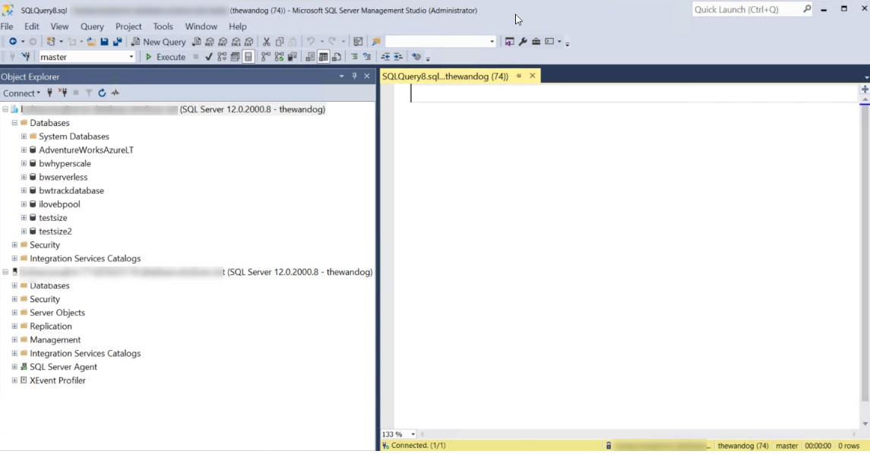
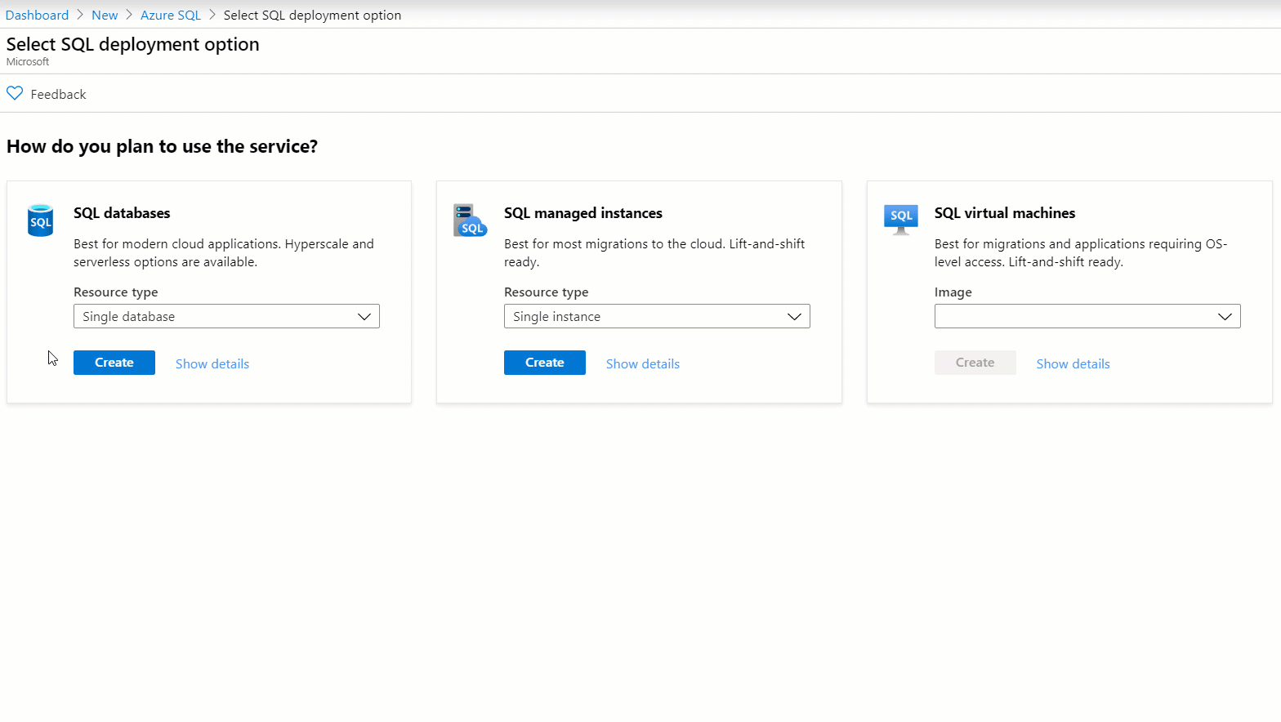
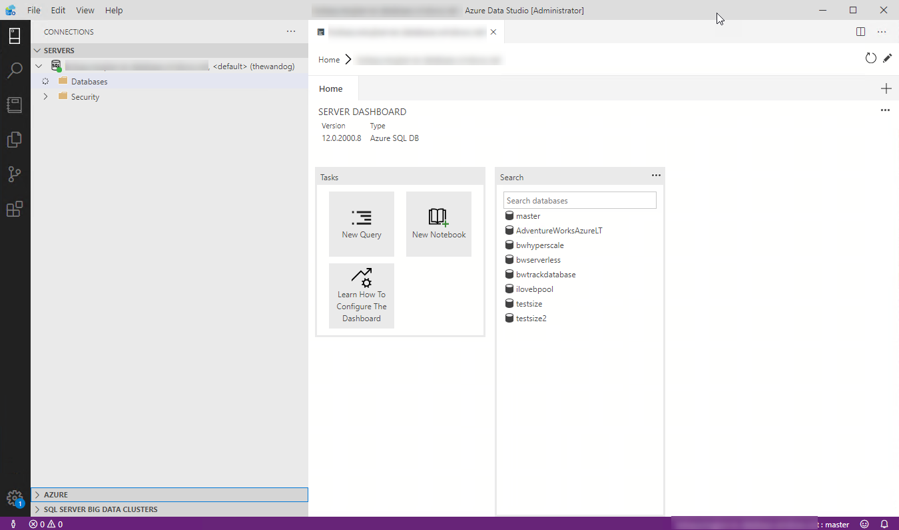


Interfaces for Azure SQL
T-SQL
Powershell
az cli
REST API
sqlcmd
bcp

Slide 33


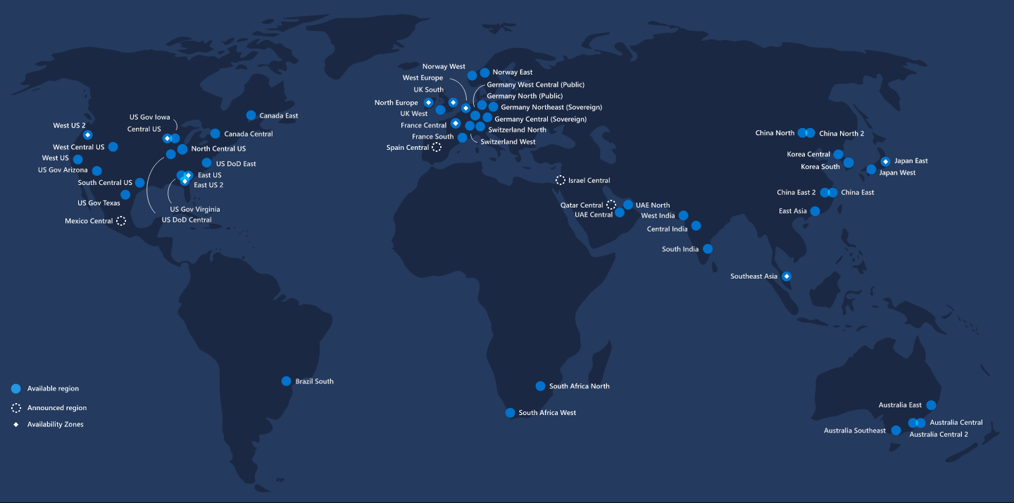


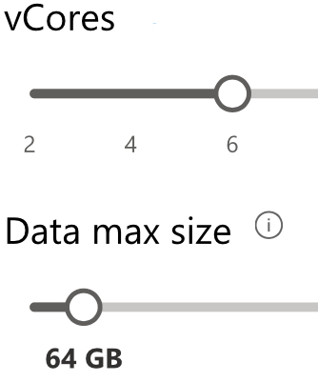
Pre-deployment Planning
*Not in managed instance
Portal
Scripts
Region
Deployment method
Deployment option
General purpose
Business Critical
Hyperscale
DTU
vCore
*
GEN 5
FUTURE
*
Purchasing model
Hardware
Service tier (SLO)
Size
Pre-deployment Planning
Deploy, Connect, and Verify
Configure
Load data
Notes:
Select deployment method: Platform, GUI, unattended, offline, CLI, T-SQL (Databases)
Select deployment option: single DB, elastic pool, single instance, instance pool
Select Region
Select purchasing model: DTU or vCore
Select service tier: General purpose, Business critical, or Hyperscale
Select hardware: Gen4, Gen5, M or Fsv series
Determine sizing: number of vCores and max data size
Select deployment method
Select deployment option
Select purchasing model
Select service tier
Select hardware
Determine sizing
Requesting quota increases to ask for more capacity for subscription and/or in a region
Region Notes:

Slide 34
Deploy
Basics
Managed Instance/Server name
Network connectivity
Data source (DB)
Server Collation (MI)
Time zone (MI)
Opt-in for Advanced data security (DB)
Terms and Privacy
Resource group
Subscription
Region
Compute + storage
Admin Login
Password
Database Name (DB)
Opt-in for pools (DB)
Public vs Private access
VNet / Firewall rules
Connection type (MI)
Additional settings
Review + create
Tags (DB)
Database Collation (DB)
Pre-deployment Planning
Deploy, Connect, and Verify
Configure
Load data
Notes:
DB:
Basics
Subscription
Resource Group
Database name
Server
Server name
Server admin login
Password
Location
Elastic pool?
Compute and storage
Purchasing model
Service tier
Compute tier
Compute hardware
vCores
Data max size
Networking
Network connectivity method – None, public, private
Firewall rules
Additional Settings
Data source
Database collation
ADS
Tags
Review + create
MI:
Basics
Subscription
Resource group
Managed instance name
Region
Compute and storage
Service tier
vCores
Storage size
MI admin login
Password
Networking
Virtual network
Connection type
Public endpoint
Additional Settings
Server Collation
Time zone
Geo-repl secondary?
Review + create
Here are some notes about

Slide 35
Key Deployment Implementation Details
Azure SQL Managed Instance
Dedicated ring or Virtual Cluster
Deployment and scale longer operations
Each instance = single VM
Pools faster deployment+density
Azure SQL Database
Dedicated SQL Instance behind the scenes
More surface area and instance level diagnostics
Hyperscale
Cannot change tier once deployed
Caches provide speed and scale
Resource Governance
Resource Governor
Windows Job Objects
File Server Resource Manager (FSRM)
Transaction Log Rates
Azure Storage Limits
Multiple VMs per node
Remote storage allows for snapshot backups
sys.dm_os_job_object
Contained by a logical Database Server
Logical Master database
Azure Service Fabric
Pre-deployment Planning
Deploy, Connect, and Verify
Configure
Load data
Notes:
Details of “Contained by a logical Database Server” can be found at https://docs.microsoft.com/en-us/azure/sql-database/sql-database-servers.
The only time multiple databases might be in the same instance for the same logical server are sub-cores (Basic, S0-S2) in DTU Standard, and elastic pools in all editions and models.
“More surface area…” includes column-store and DMVs.

Slide 36
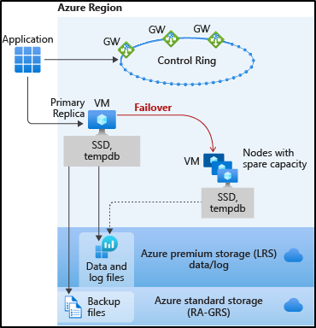
HA for Basic, Standard, and General Purpose
Remote storage provides data redundancy within a datacenter
Recovery depends on spare capacity
Notes:
Images from docs https://docs.microsoft.com/en-us/azure/sql-database/sql-database-high-availability

Slide 37
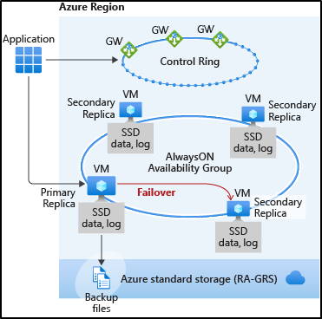
HA for Business Critical and Premium
3 to 4 replicas automatically created
AlwaysON replication
Automatic failover
Read Scale-Out

Slide 38
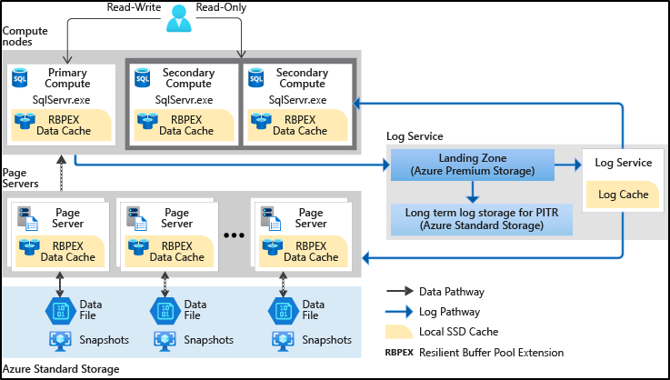
HA for Hyperscale
Separated compute and storage
Paired page servers
Redundant log and data storage
Notes:
Hyperscale Approach:

Slide 39


WEST US
SQL Connectivity
Architecture
23.99.34.75
GW
GW
mysqldbsrv.database.windows.net
104.42.238.205
GW
GW
westus1-a.control.database.windows.net
104.42.238.205,1433
GW
proxy (default)
(1) redirect-find-db
GW
GW
(2) redirect-query
..westus1-a.worker.database.windows.net
13.123.237.158, [11000 -11999]
Pre-deployment Planning
Deploy, Connect, and Verify
Configure
Load data
Notes:
https://docs.microsoft.com/en-us/azure/sql-database/sql-database-connectivity-architecture
Key points:
Explain from perspective of a client connection
Proxy/Redirect are server level settings apply to all databases
Clients need specific connectivity for Redirect to work – port range plus all Azure Ips in a region

Slide 40



Network security – SQL Database
Allow access to Azure services
Firewall Rules
Virtual Network Rules
VNET Peering
Private Link
VMVNET-EUS
US EAST
SQLDBVNET-EUS
No access to Internet
US EAST
Azure VM
10.0.0.3
127.33.201.5
Azure VM
10.0.0.5
174.17.218.16
VMVNET-WUS
10.0.0.2
mysqldbsrv.database.windows.net
US WEST
mysqldbsrv.privatelink.
database.windows.net
10.0.0.5
westus1-a.control.
database.windows.net
104.42.238.205
Private Endpoint
Azure VM
102.14.157.9
10.0.0.1
VNET Gateway
VNET Gateway
Vnet2Vnet
P2S, S2S VPN Express Route
On-premises
Identity & access management
Network security
Data protection
Security management
Notes:
Private link:
Benefits:
Private endpoint for Azure SQL (server level)
On-premises connectivity via Express Route/VPN
Data exfiltration protection
Can be part of network monitoring strategy using a Network Virtual Appliance (NVA)
Currently in public preview for:
Azure SQL Database (singleton databases)
Azure SQL Data Warehouse
Azure Storage

Slide 41
Network security – SQL Managed Instance
VNET Peering
VMVNET-EUS
US EAST
SQLDBVNET-EUS
US EAST
Azure VM
10.0.0.3
127.33.201.5
sql-mi-2.25984.database.windows.net
Azure VM
10.0.0.5
10.0.0.254
174.17.218.16
VMVNET-WUS
10.0.0.2
US WEST
sql-mi-1.259fs.database.windows.net
Private Endpoint
10.0.0.252
Azure VM
MI Subnet
102.14.157.9
10.0.0.1
VNET Gateway
VNET Gateway
Vnet2Vnet
P2S, S2S VPN Express Route
On-premises
Identity & access management
Network security
Data protection
Security management
Notes:
Trying to figure out how to compare this to a SQL Server network security scenario? I think the only one that probably applies is Windows Firewall which is a reality for all SQL Server deployments even in their data center.

Slide 42
Demo

Slide 43
Topic 1
Bullet
Bullet
Bullet

Slide 44
Summary
Bullet
Bullet
Bullet

